Slide 1

18ECE340T- MACHINE PERCEPTION WITH COGNITION
UNIT-2
Centroidal Profiles and Handling occlusions
Reference Book:
Computer and Machine Vision by E.R.Davies

Slide 2
CENTROIDAL PROFILES
DEFINITION: A method for characterizing and analyzing the shape of an object having a well defined boundary.
The centroid of the shape is first determined.
Then a polar (r,θ) plot of the boundary is computed relative to this origin
This plot is the centroidal profile,
ADVANTAGE of permitting template matching for a 2-D shape to be performed relatively efficiently as a 1-D process.

Slide 3
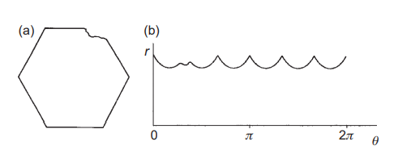
CENTROIDAL PROFILES
THE CENTROID OF THE OBJECT IS FIRST LOCATED
A POLAR COORDINATE SYSTEM IS SET UP RELATIVE TO THIS POINT AND THE OBJECT BOUNDARY IS PLOTTED AS AN (R, Θ) GRAPH—OFTEN CALLED A “CENTROIDAL PROFILE”
CENTROIDAL PROFILES FOR OBJECT RECOGNITION AND SCRUTINY

Slide 4
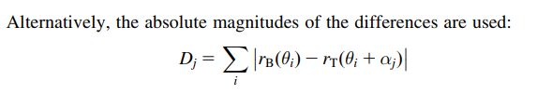
CENTROIDAL PROFILES
(a) hexagonal nut shape in which one corner has been damaged.
(b) centroidal profile, which permits both straightforward identification of the object and detailed scrutiny of its shape.

Slide 5
CENTROIDAL PROFILES
At this stage, it may be noted that the matching process also leads to the possibility of inspecting the object’s shape as an inherent part of the process.
In principle, this combination of capabilities makes the centroidal profile technique quite powerful.

Slide 6
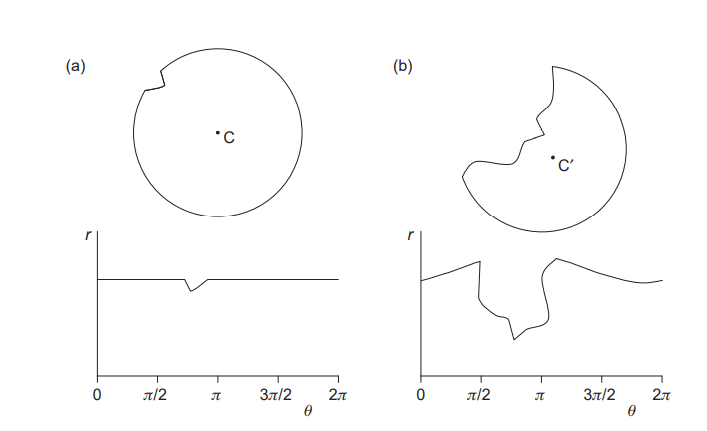
PROBLEMS WITH THE CENTROIDAL PROFILE APPROACH

Slide 7
PROBLEMS WITH THE CENTROIDAL PROFILE APPROACH
(a) A circular object with a minor defect on its boundary; its centroidal profile appears beneath it.
(b) The same object, this time with a gross defect: because the centroid is shifted to C0 the whole of the centroidal profile is grossly distorted
The problem arises because quantization should ideally be uniform along the θ-axis so that the two templates can be moved conveniently
relative to one another to find the orientation of best match.
Finally, computation times can still be quite significant, so some timesaving
procedure is required.

Slide 8
Contd…
uneven spacing of the pixel boundaries along the θ dimension of the (r, θ) graph.
To some extent this problem can be avoided by deciding in advance on the permissible values of θ
and querying a list of boundary points to find which has the closest θ to each permissible value.

Slide 9
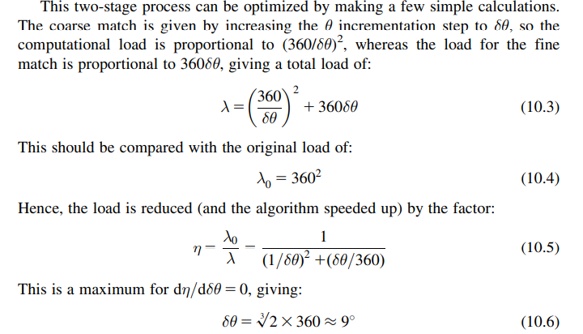

Slide 10
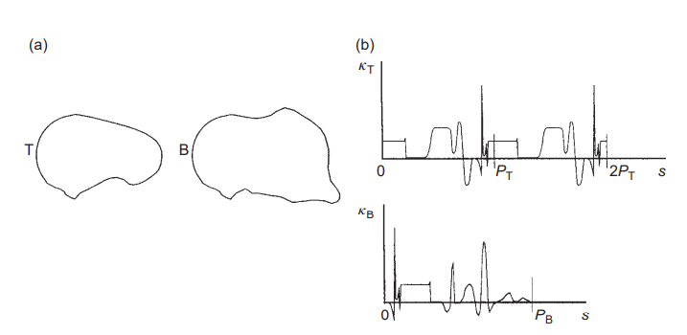
Handling occlusions
TACKLING THE PROBLEMS OF OCCLUSION:
A MAJOR EFFECT OF OCCLUSIONS IS THAT THE PERIMETER OF THE OBJECT IS ALTERED, SO P CAN NO LONGER BE USED TO INDICATE ITS SCALE.
THE OVERALL BOUNDARY IS THAT OF TWO OVERLAPPING OBJECTS, THE OBSERVED PERIMETER PB WILL BE GREATER THAN THE IDEAL PERIMETER PT.
MATCHING A TEMPLATE AGAINST A DISTORTED BOUNDARY.

Slide 11

(a) the basic problem
(b) matching in (s, κ) space.
When a boundary B is broken (or partly occluded) but continuous, it is necessary to attempt to match between B and a template T that is doubled to length 2PT, to allow for T being severed at any point.
When carrying out the match, we basically use the difference measure

Slide 12
Contd…
where j and k are the match parameters for orientation and boundary displacement, respectively.
Note that the resulting Djk is roughly proportional to the length L of the boundary over which the fit is reasonable.
Djk appears to improve as L decreases.
DISADVANTAGE:
If the boundary is occluded in more than one place, then L is at most the largest single length of unoccluded boundary (not the total length of unoccluded boundary),
since the separate segments will in general be “out of phase” with the template

Slide 13
ADVANTAGE:
Speed is enhanced
Registration accuracy can be retained or even improved by careful selection of salient features.
PT<PB, and it is necessary to match over a length PT rather than 2PT, since T is no longer periodic
Once various segments have been located, the boundary can be reassembled as closely as possible into its full form,
At that stage defects, occlusions, and other distortions can be recognized overtly and recorded.

Slide 14
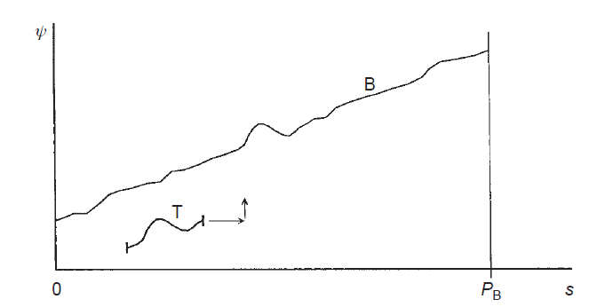
Matching a short template to part of a boundary
A short template T, corresponding to part of an idealized boundary, is matched against the observed boundary B.
Strictly speaking, matching in (s, ψ) space is 2-D, although there is very little uncertainty in the vertical (orientation) dimension.

